Slide 1

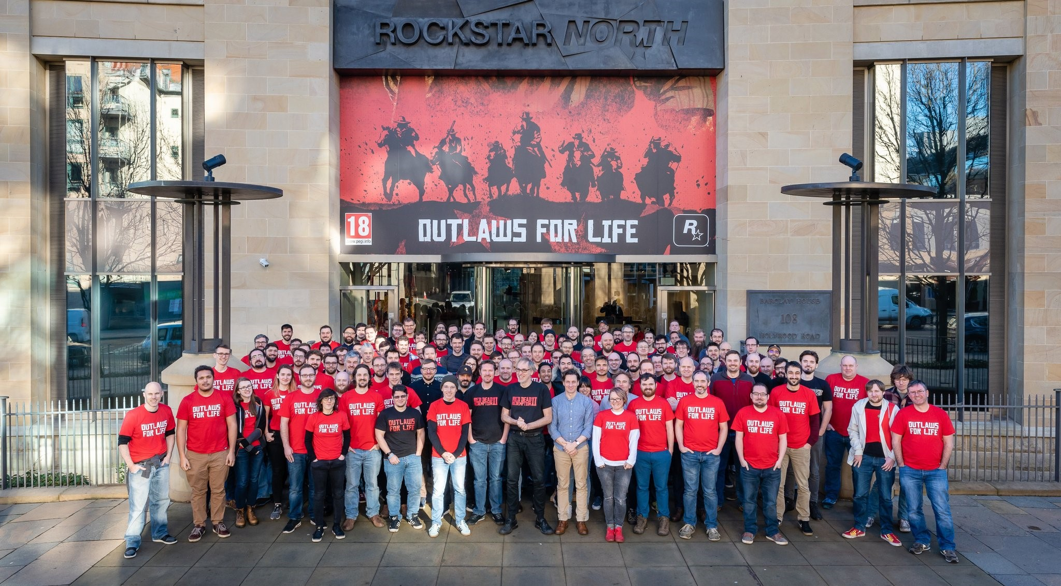
BSc Hons Computer Game Design and Development GDV4000 Introduction to Games Industry Practice
History of the Games Industry Part 2

Slide 2
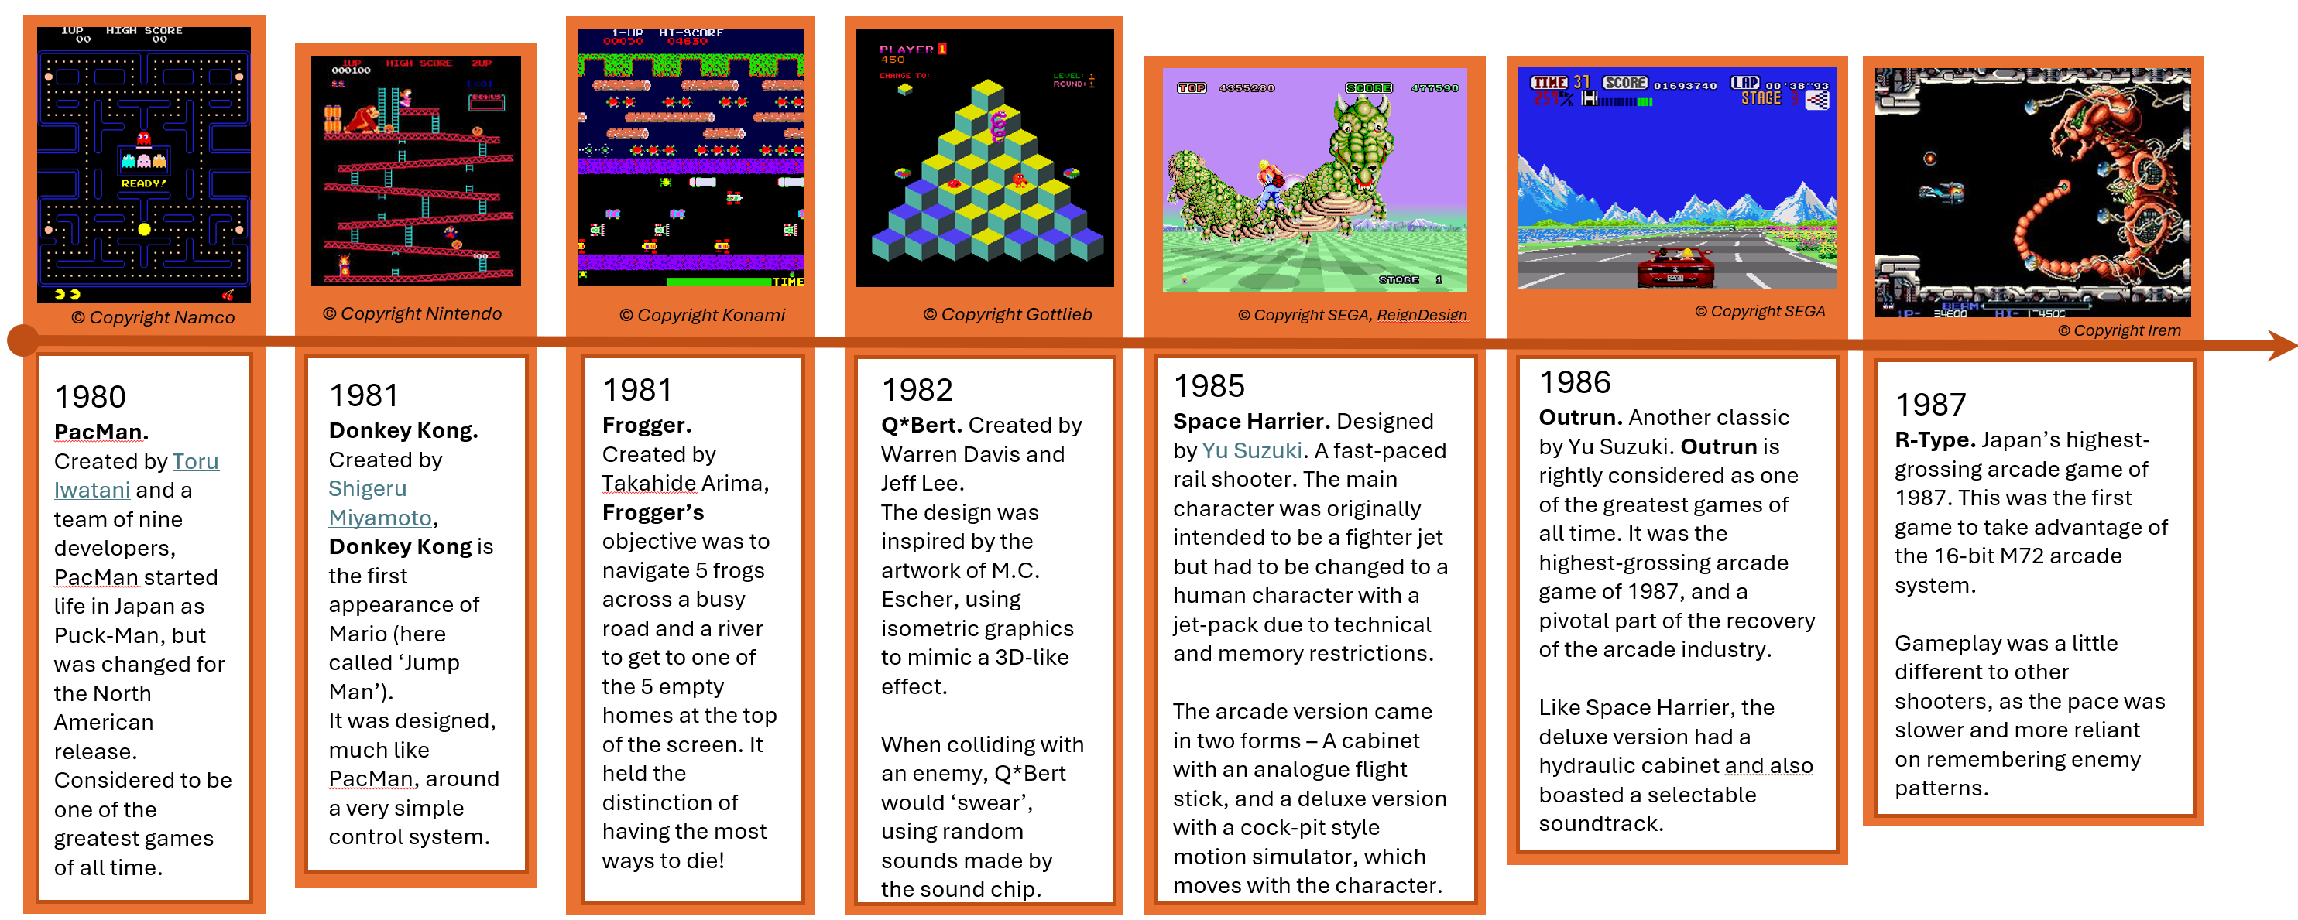
A Brief History of the Games Industry Part 2
Where we left off… The 1980’s
Home Computing and video game journalism really take off!

Slide 3
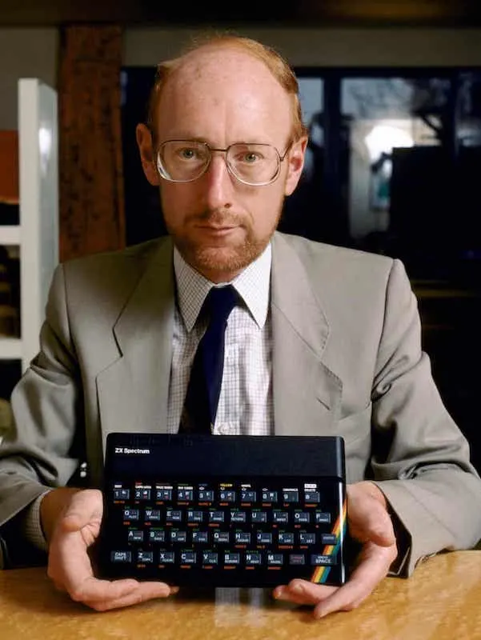
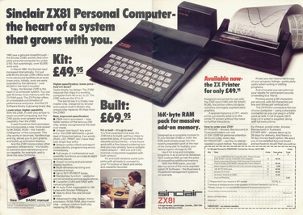
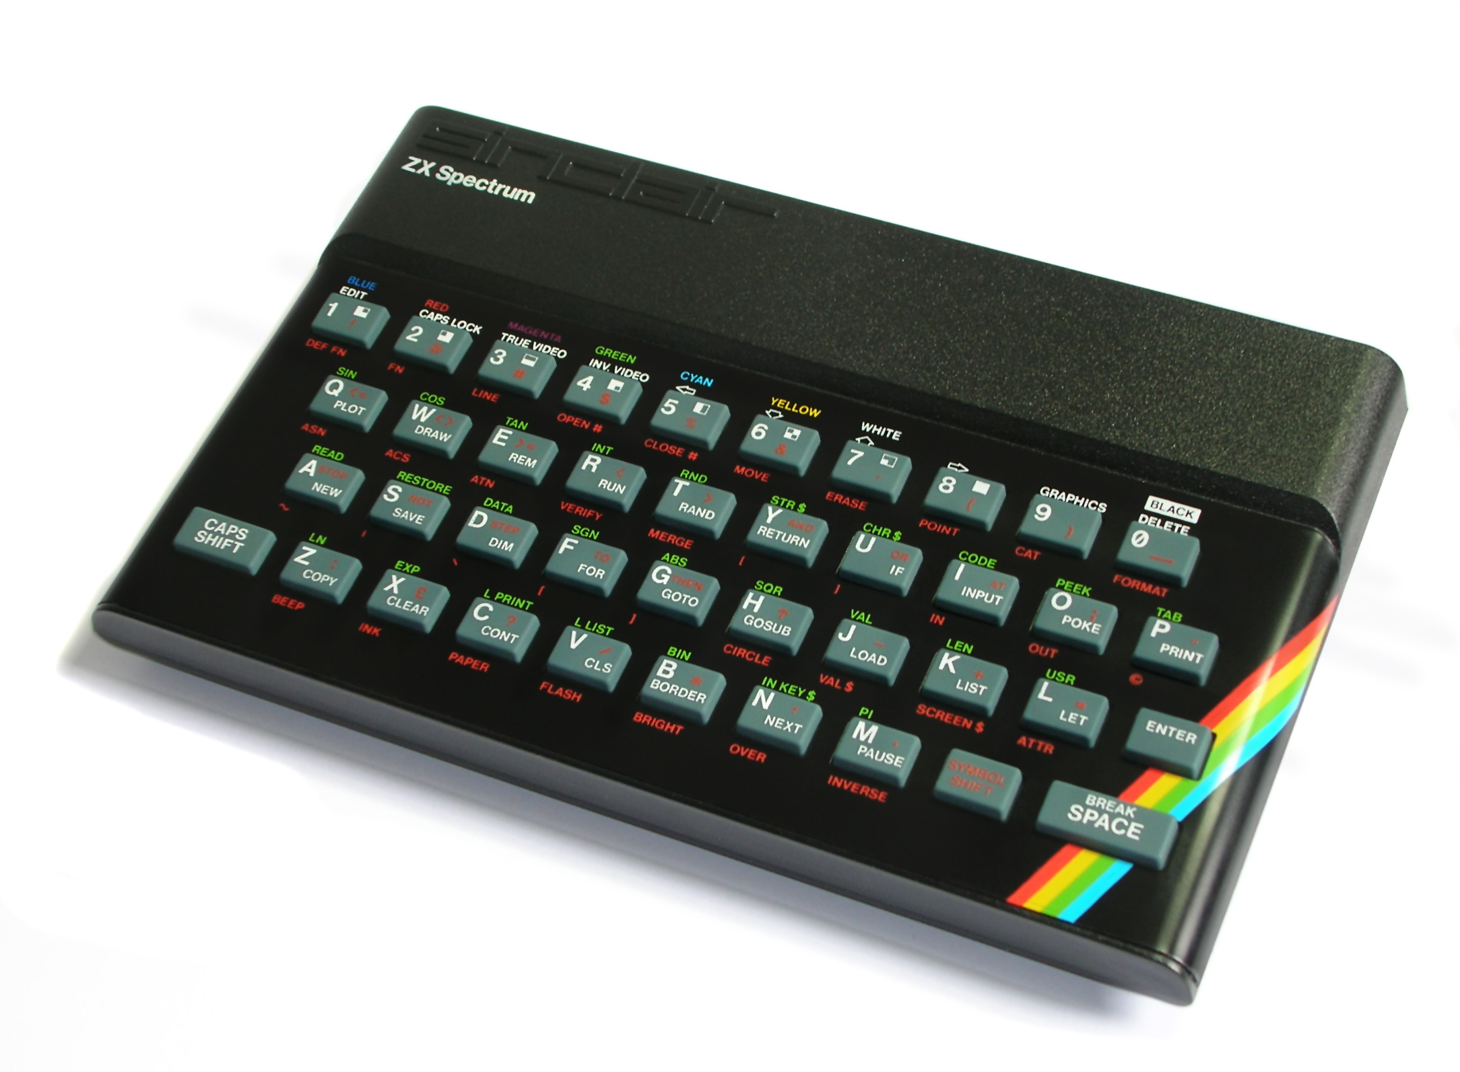
A Brief History of the Games Industry Part 2
The early 1980s saw a boom in home computing in the UK, largely thanks to British inventor and pioneer, Sir Clive Sinclair.
The ZX81 had only 1K of memory, a monochrome output and no sound, but it allowed home users to be able to learn programming at a low price of £69.99 or £49.99 if you purchased it in kit form! The ZX81 made Sinclair a millionaire and one of the UK’s highest-profile businessmen.
The ZX Spectrum 48K launched in 1982, with its eye-catching design and rubber keys. It now had colour and sound, and it inspired a generation of bedroom programmers. It is widely regarded as the most influential computer of the 1980s

Slide 4



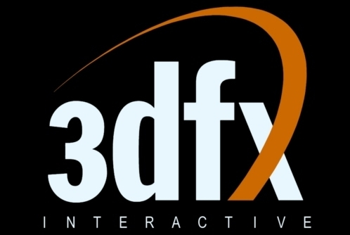
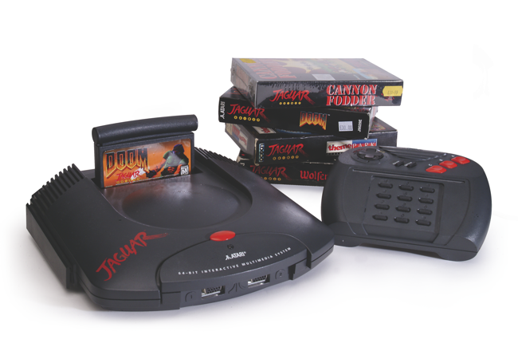
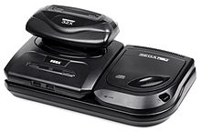
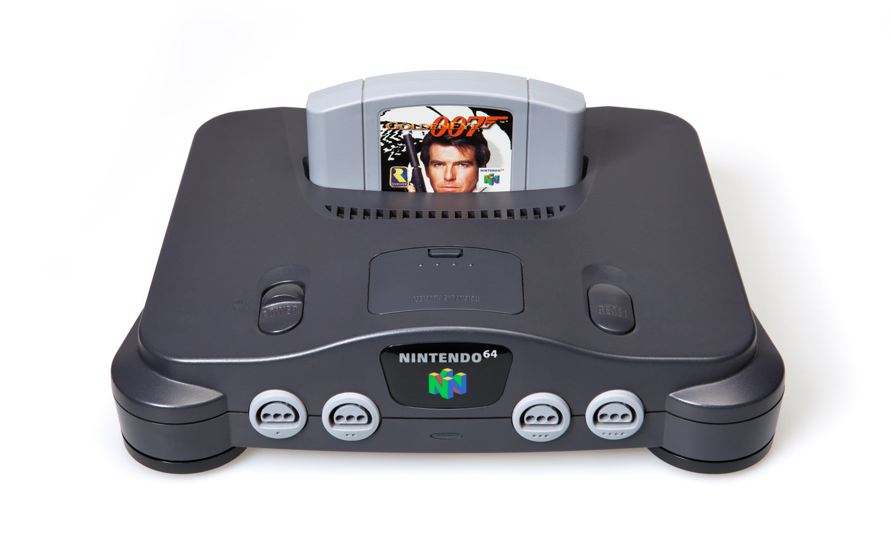
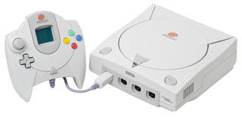
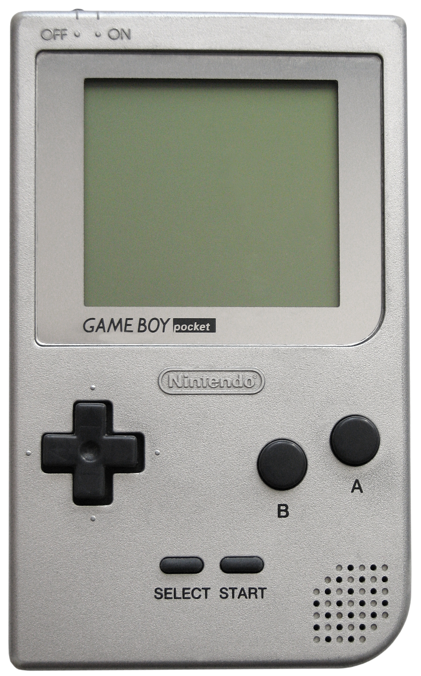
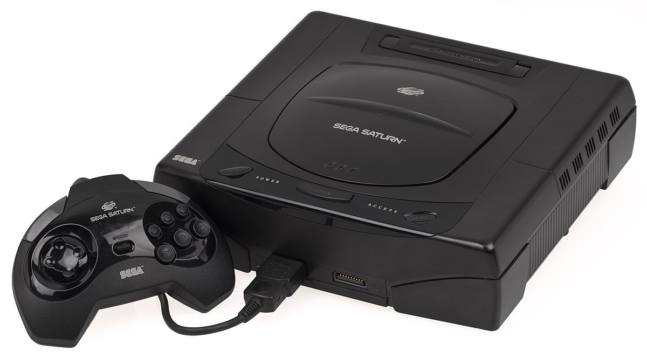


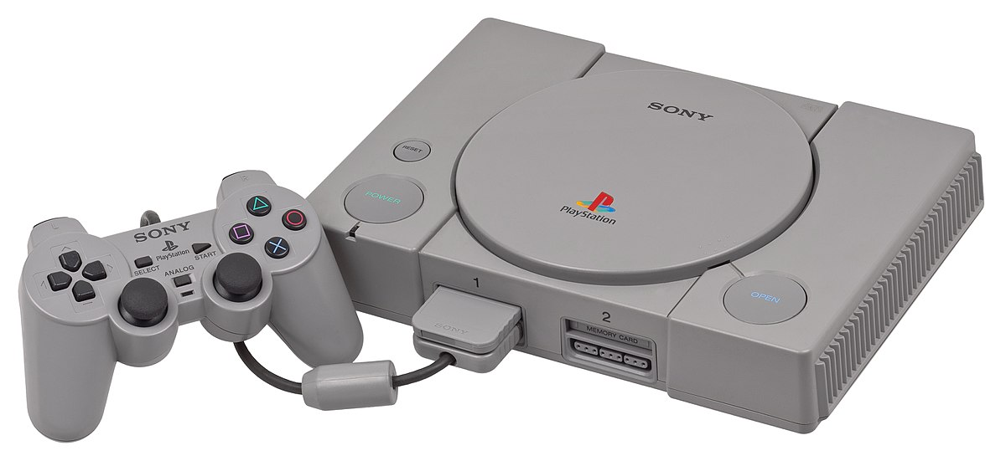
A Brief History of the Games Industry Part 2
1990s…
Direct3D (1996)
OpenGL 1.0. (1992)
NVidia inc. (1993)
3dfx Voodoo / Glide API (1996)
NVidia Riva 128 (1997)
SEGA 32X (1995)
Atari Jaguar (1994)
SEGA Saturn (1995)
N64 (1997)
SEGA Dreamcast (1999)
Gameboy Pocket (1996)
PlayStation (1995)
GoldenEye © Rare
MarioKart 64 © Nintendo

Slide 5

A Brief History of the Games Industry Part 2
Continued growth of GUIs
Development of dedicated 3D Graphics cards
CD Rom became the predominant method for data storage – Cartridges also still in use.
Emergence of the Internet and competitive gaming
More popular licensing of games
Consoles were the dominant platform during this period – Sega Megadrive, SNES, N64, PlayStation…
Early attempts at VR

Slide 6

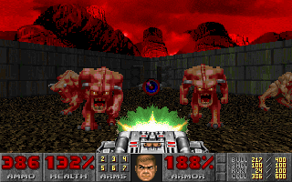
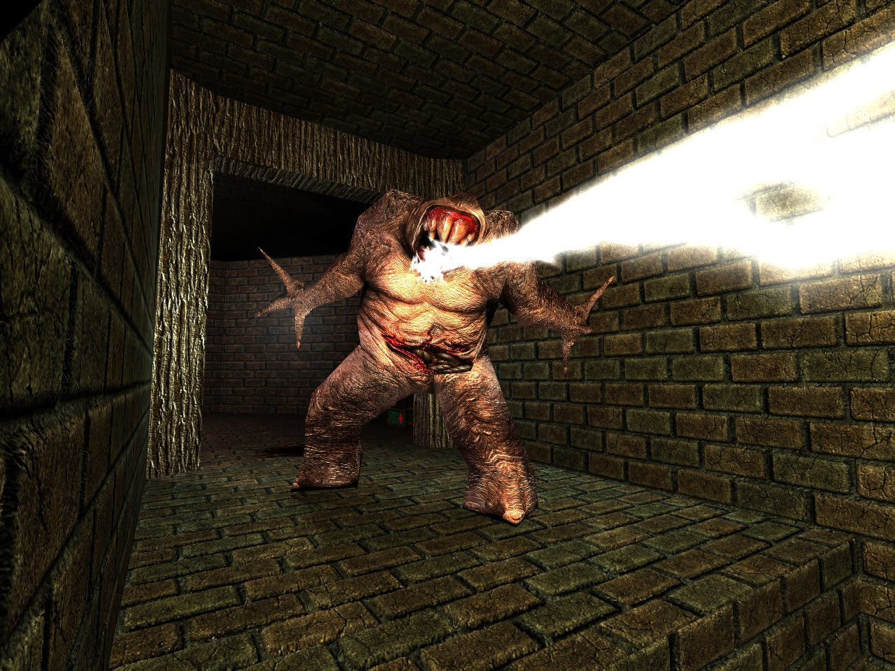
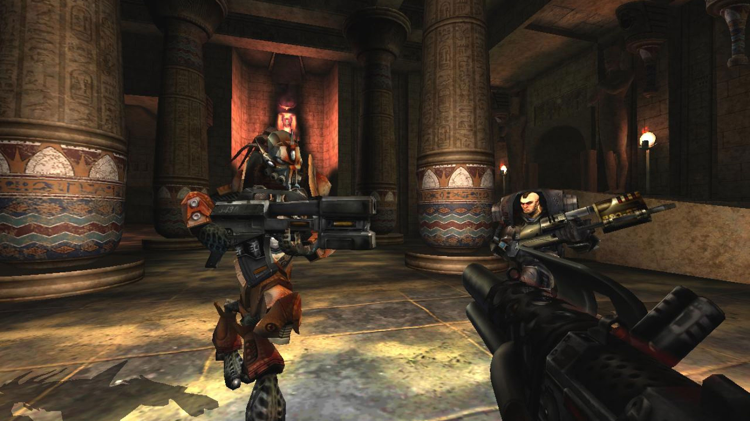
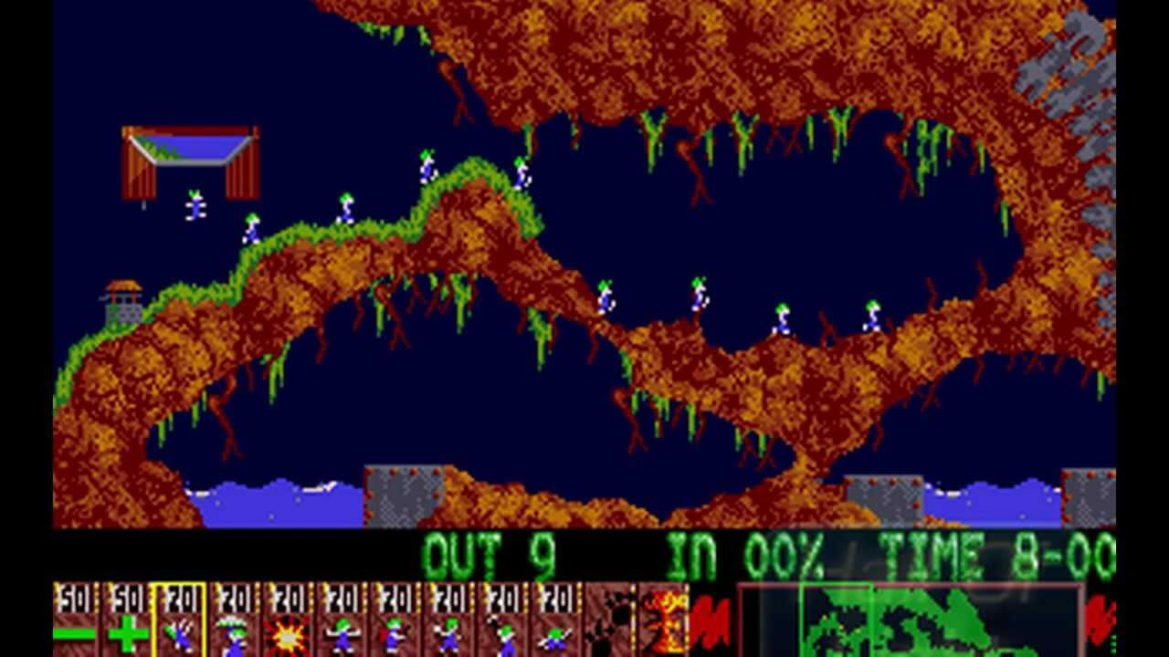
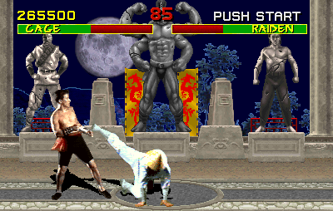
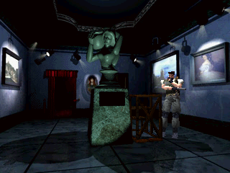
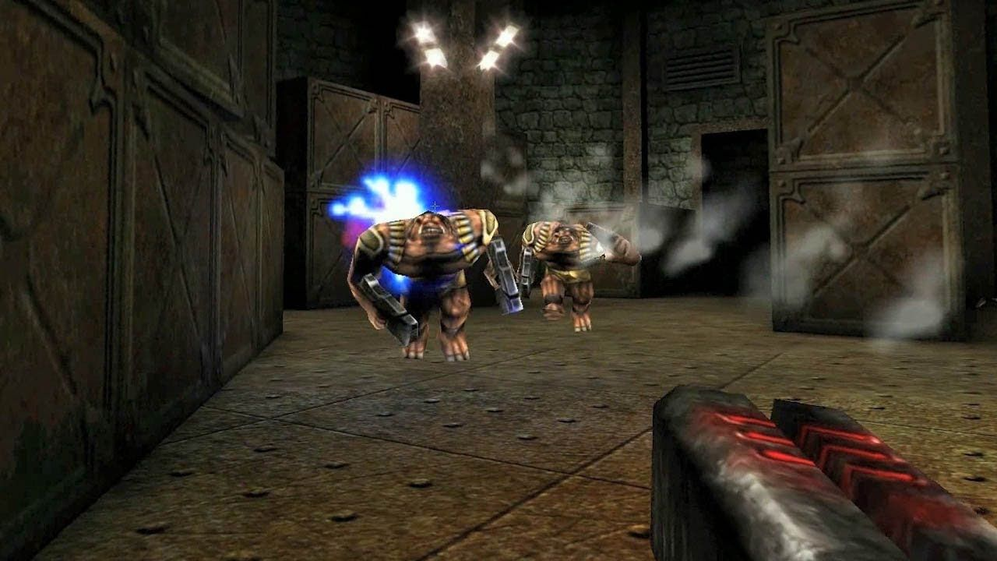

A Brief History of the Games Industry Part 2
1990s…
Super Mario World © Nintendo
Doom © Id
Quake I © Id
GoldenEye © Rare
Unreal Tournament © Epic
Super Mario World – Miyamoto & Tezuka (1990)
Doom – Carmack & Romero (1993)
Quake I – Camack & Romero (1996)
GoldenEye – Hollis & Botwood (1997)
Unreal Tournament– Bleszinski & Schmalz (1999)
Lemmings © DMA Design
Mortal Kombat © Midway
Resident Evil © Capcom
Unreal © Epic
Half Life © Valve
Lemmings – Jones, Kay & Dailly (1991)
Mortal Kombat – Boon & Tobias (1992)
Resident Evil – Fujiwara (1996)
Unreal – Bleszinski & Schmalz (1998)
Half-Life (1998)

Slide 7

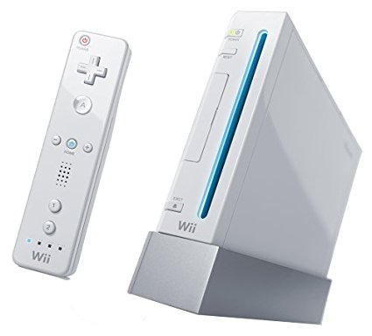
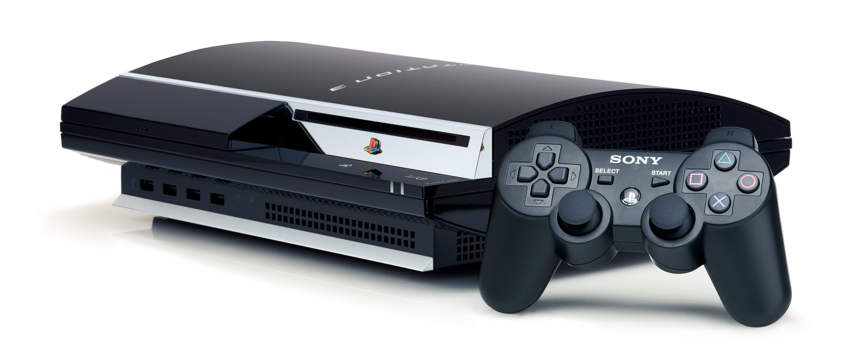
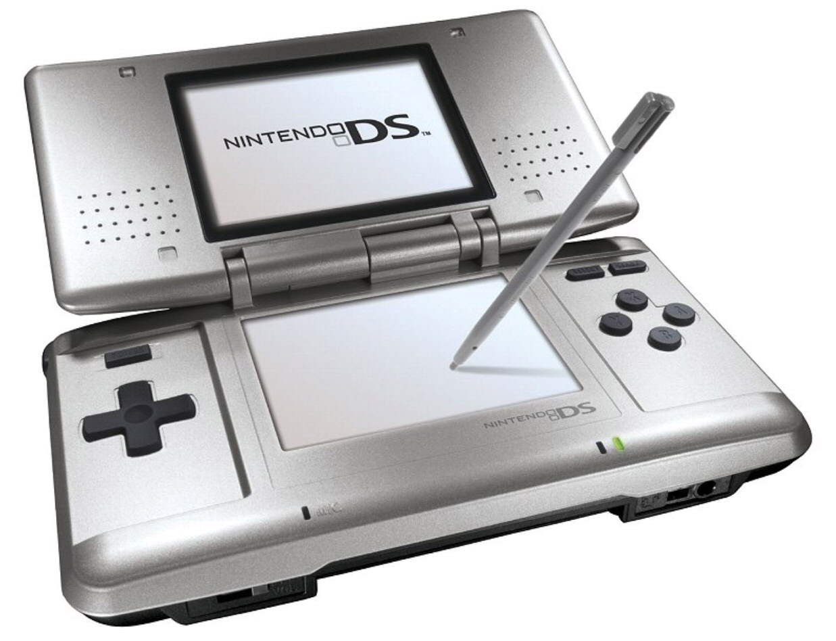
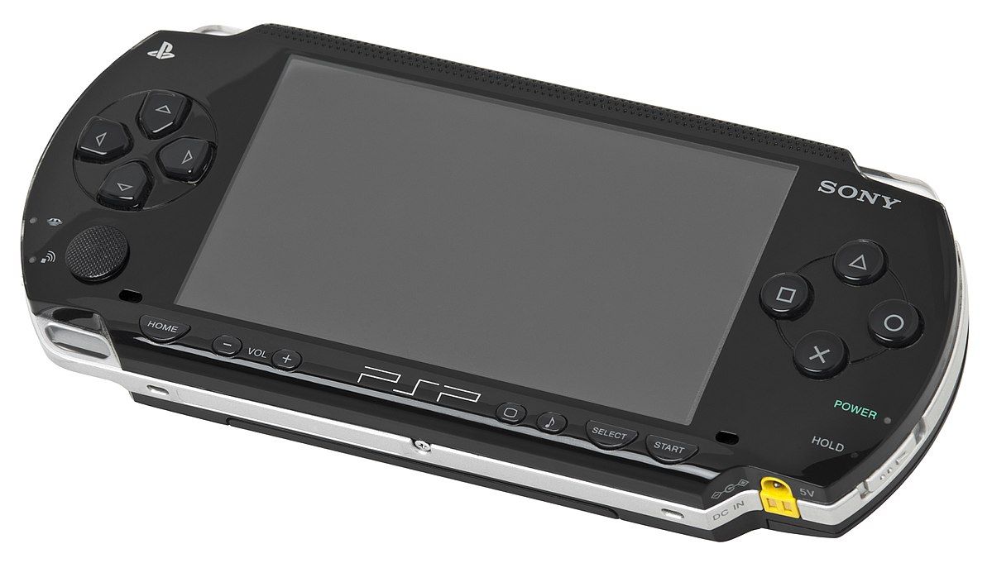
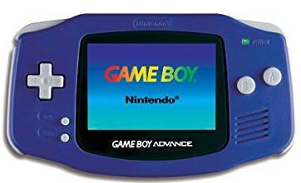
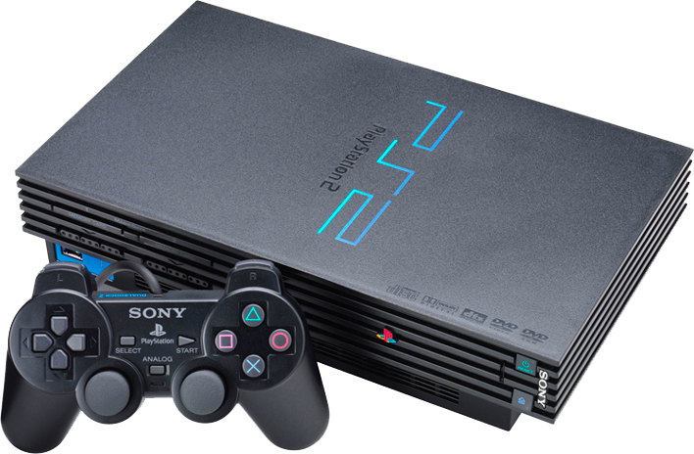

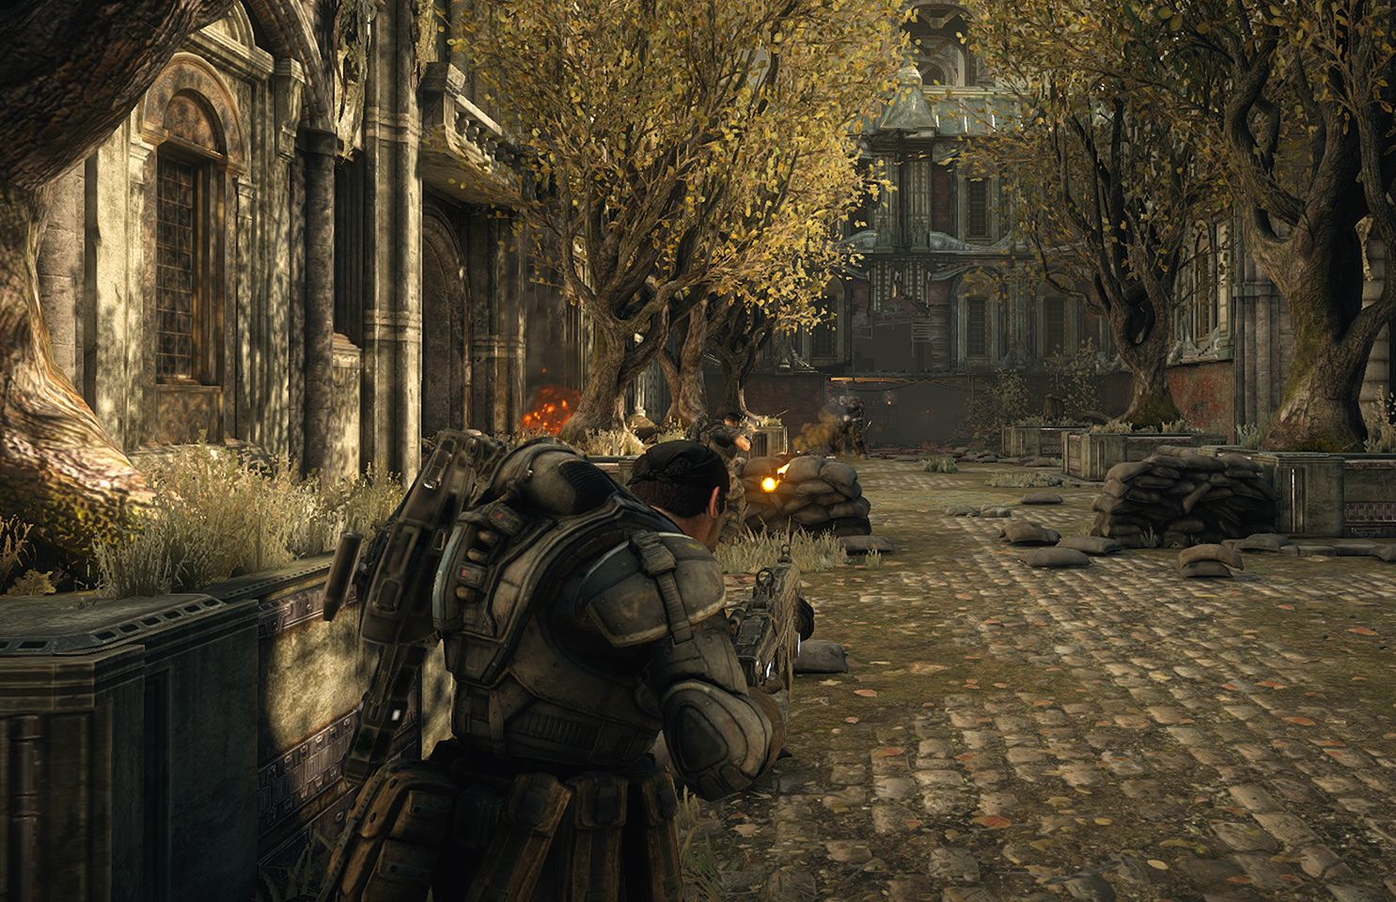
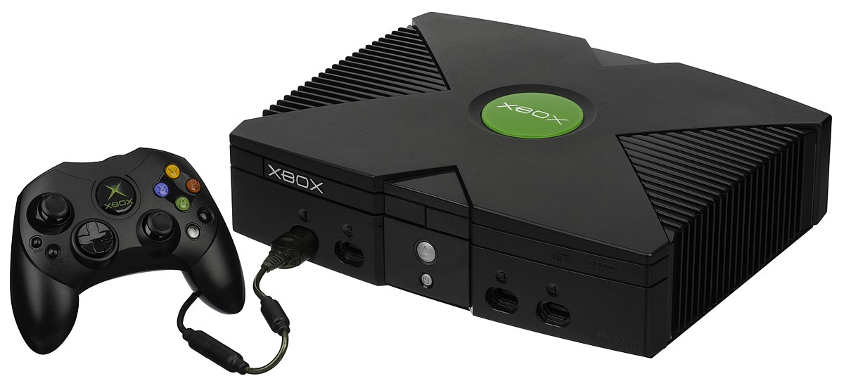


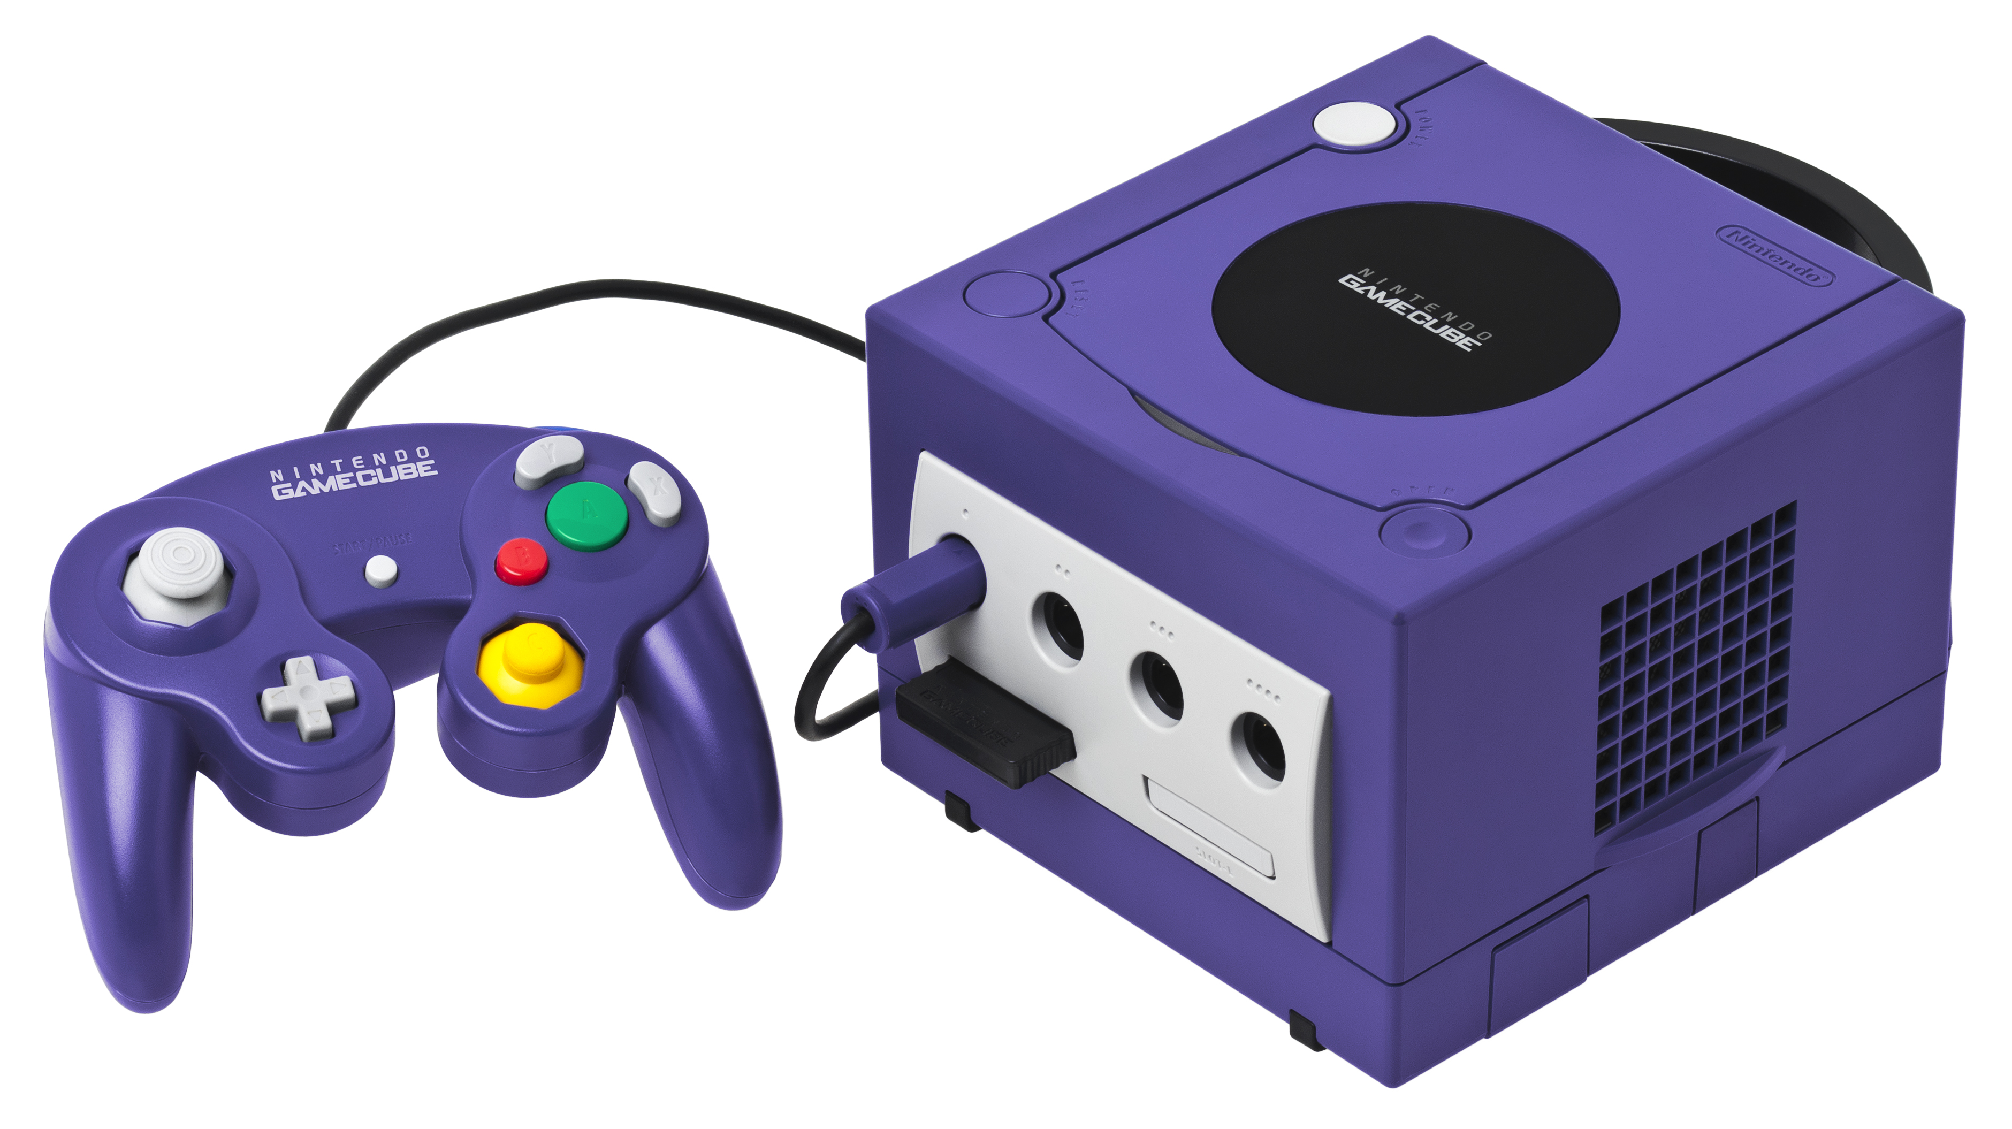
A Brief History of the Games Industry Part 2
2000s…
Nintendo DS (2005)
Sony PSP(2005)
Xbox 360 (2005)
Wii (2006)
PlayStation 3 (2007)
Gameboy Advance (2001)
Xbox (2002)
Sony PlayStation 2 (2000)
Microsoft Xbox (2001)
Halo © Microsoft / Bungie
Original iPhone (2007)
Gears of War © Epic Games / Microsoft (2006)
Ico (2001)
Nintendo GameCube (2002)

Slide 8
A Brief History of the Games Industry Part 2
2000s and beyond…
On PCs, Windows becomes the pre-dominant platform for gaming…
Windows XP (2001) DirectX 9 – 9c
Windows Vista (2006) DirectX 10
Windows 7 (2009) DirectX 11
Windows 8 (2012)
Windows 10 (2015) DirectX 12
Windows 11 (2021)
Valve launch Steam in 2003, initially to provide a platform for patching Counter-Strike, and provide access to Valve releases.
Marked growth in smart phones and casual / mobile gaming, direct-to-market App stores towards the end of the decade.
Indie development continues to grow (Fez, Minecraft, Phasmophobia), with crowdfunding becoming more popular.

Slide 9
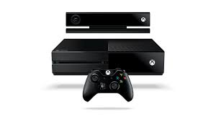
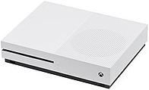

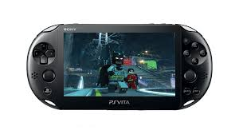
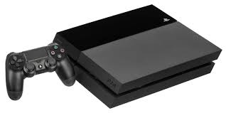
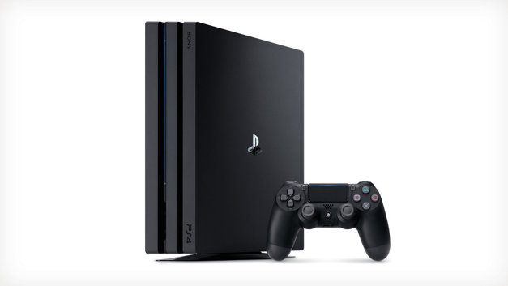

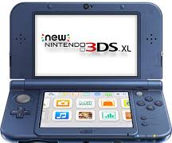
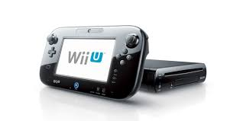
A Brief History of the Games Industry Part 2
2010s…
Xbox One X “Project Scorpio” (2017)
Xbox One (2013)
Xbox One S (2016)
Nintendo 3DS (2011)
PS Vita (2012)
Nintendo Switch (2017)
PlayStation 4 (2013)
Wii U (2012)
PlayStation 4 Pro (2016)
Market push to 4K / HDR

Slide 10
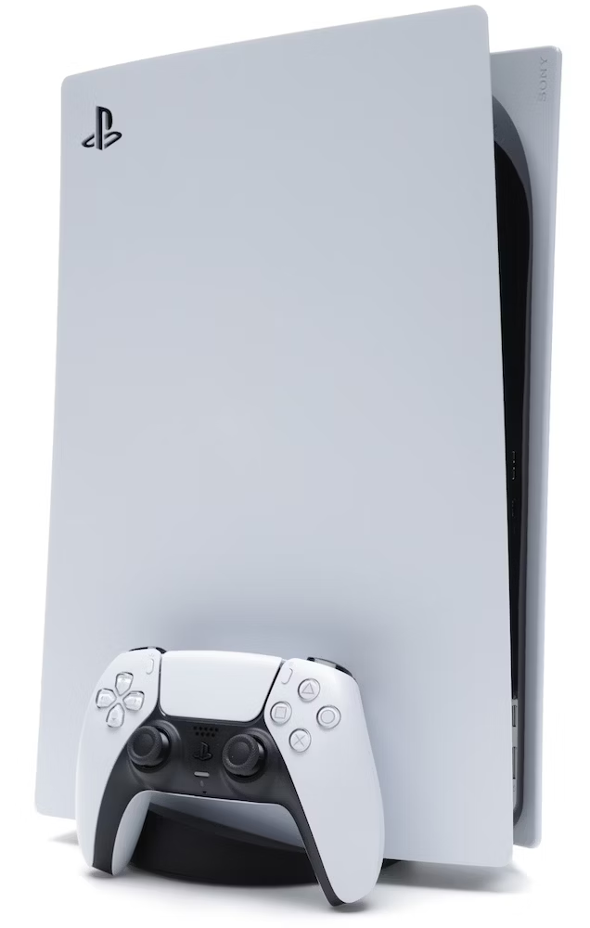
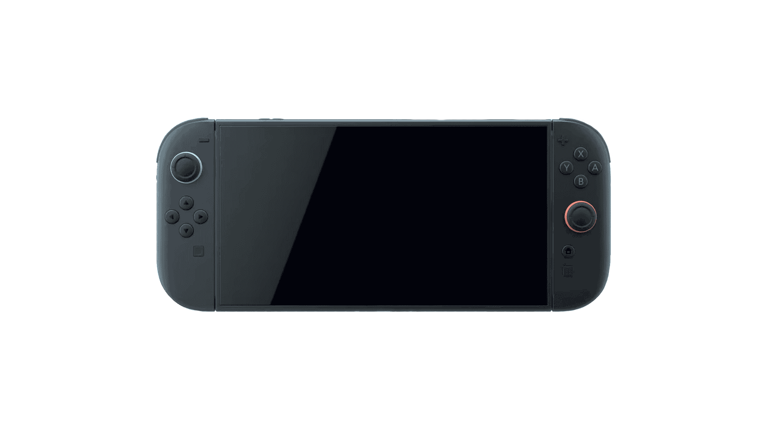

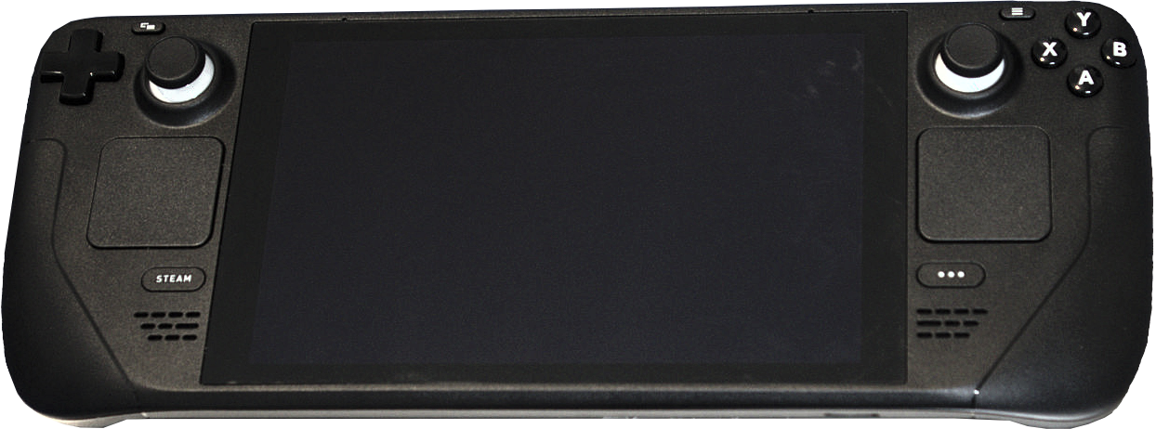

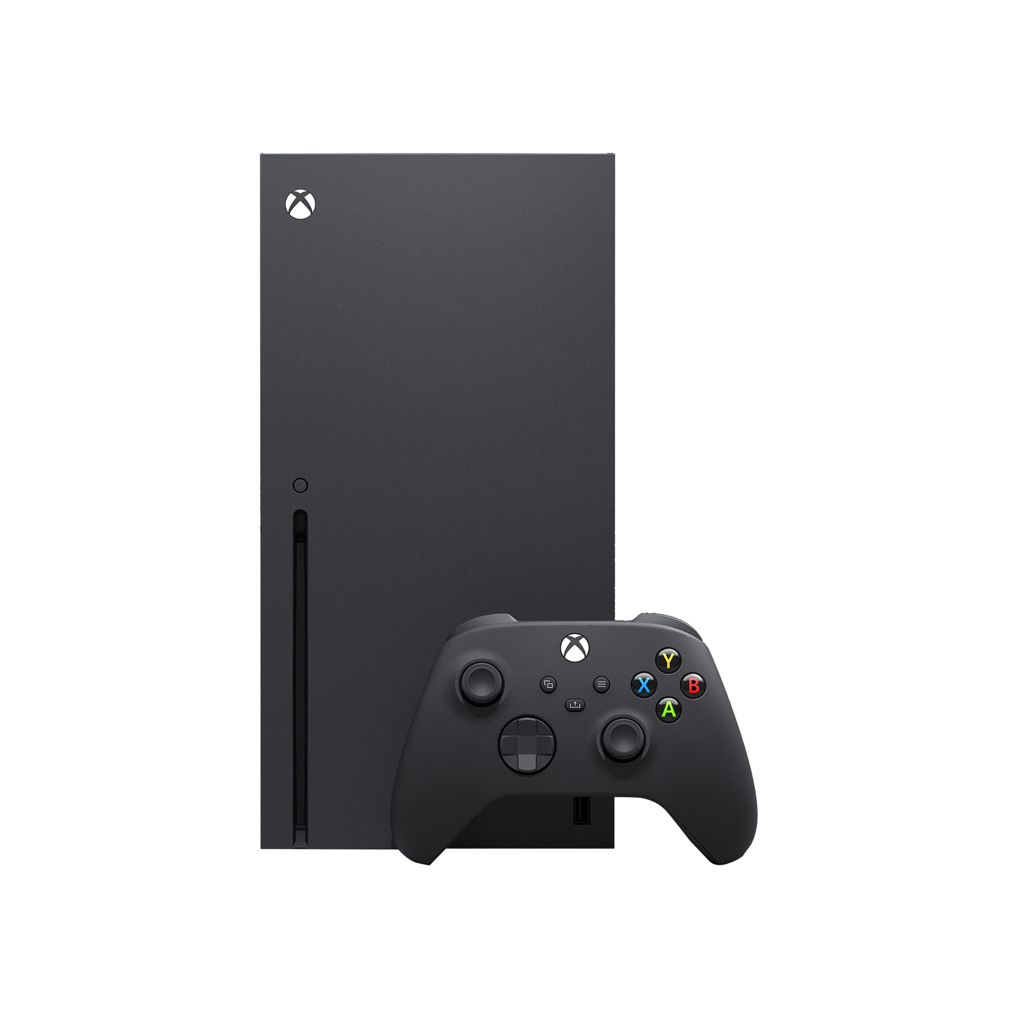

A Brief History of the Games Industry Part 2
2020s…
PlayStation 5 (2020)
Valve Steam Deck (2022)
Nintendo Switch 2 (2025)
Valve Steam Machine (2026)
Xbox Series X (2020)
Xbox Series S (2020)

Slide 11
A Brief History of the Games Industry Part 2
The 1990s saw a radical evolution in video games. Dedicated 3D graphics cards started a shift from 2D games to full 3D games.
Console Wars – SEGA and Nintendo traded popularity and sales throughout the 90s, with SEGA boasting a large library of third-party games, whereas Nintendo focused more on fewer in-house titles with more time devoted to development (Kelion, 2014).
Exclusivity – Nintendo had Mario, SEGA had Sonic the Hedgehog. Through the 80s many games were available on multiple platforms. The 90s into the 2000s saw a shift to games and well-known IPs being used to sell the console.

Slide 12
What might we see in the Future?
Manu Rosier of Newzoo recently shared some predictions about the year ahead (Hicks, 2025):
Half-Life 3 will be unveiled, and it will be a statement on high-end PC gaming, both the game and the technical capabilities.
GTA VI will be delayed yet again. This will start to negatively twist the narrative around Rockstar’s dedication to polish into one of scope and overly complex development. Expectation fatigue will set in, and it may become a victim of its own hype.
AI Investment will continue to hit the hardware components, causing pressure on hardware prices and general availability. Developers may have to curtail the technical demands of their projects to meet a market who cannot afford to upgrade their devices.
Steam Machine will launch but struggle to find a market. Gamers with high-end PCs will see no reason to switch, and without an incentive (RRP, exclusives) console players will be in a similar position.

Slide 13
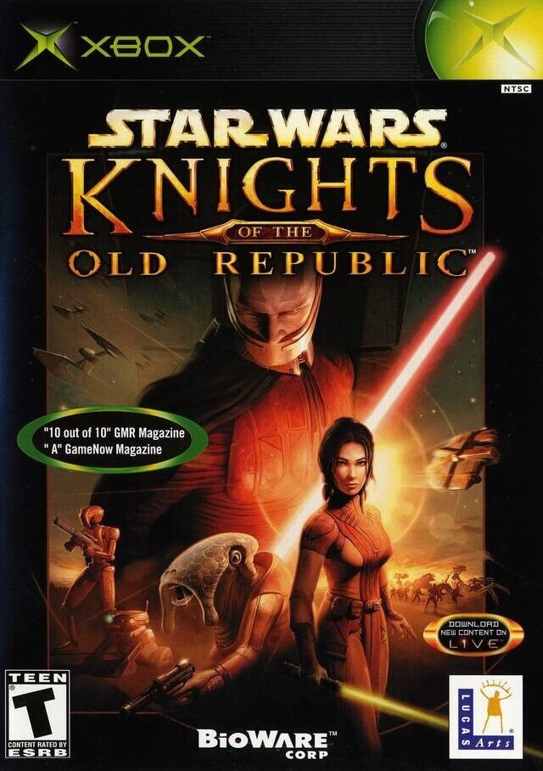


5. IP, Social, and Ethical Issues 1
Intellectual Property (IP)
IP is crucial (as we saw earlier with what happened with Pong), given how much value we place on brands. IPs such as Star Wars, Halo, and James Bond, have been used to attract customers to buy particular consoles.
When something new is generated (stories, characters…) that is new IP.
Your intellectual property can be protected in a few different ways:
Copyright: From the moment someone creates a piece of work, they retain the copyright until, under UK law, 70 years after the year of their death.
Patents: A patent enables the author to publish their ‘invention’ in return for a state-granted monopoly on it. Others wishing to implement the invention require a licence / permission. The patent holder reserves the right to restrict use and development of the invention.
Mathematical concepts cannot be patented (they are discovered rather than invented), but in certain regions, such as the US, software can! This has led to a fundamentally broken system, with low-quality patents being registered, and ‘Patent Trolls’ hoarding patents in order to extract licence fees from unwitting users of their IP, without ever producing any products of their own.

Slide 14
5. IP, Social, and Ethical Issues 1
Intellectual Property (IP)
Patents continued…
Patents can be expensive, and also as a legal document difficult for a layperson to follow.
It can be even more expensive to defend a patent! Consider the issues currently underway with Nintendo and Pocketpair, the makers of Palworld. Nintendo are currently pursuing legal action and filing a lawsuit for patent infringement rather than copyright infringement (Yin-Poole, 2024).
Most large companies cross-licence patents, but smaller companies cannot do this, but this is offset by how costly it would be for a larger company to chase up a smaller one, given that it would cost more to sue them than they would likely receive in return.

Slide 15
5. IP, Social, and Ethical Issues 1
Intellectual Property (IP)
Trademarks – A trademark is a label or logo that is used to identify your brand/ IP in the marketplace. There are two types…
®(Registered Trademark) – A company can register their trademark within a region to state formally that the IP is their key brand or identifier.
™(Trademark) – The company is stating a claim to the mark but has not registered it. Despite it not being registered, the company can still argue that it is their brand in the marketplace.
Example – Unity has a set of guidelines for how and where their logo may be used, including the colour scheme and whether it can be animated.

Slide 16
5. IP, Social, and Ethical Issues 1
Intellectual Property (IP)
Trade Secrets – Mainly for technical innovations but can extend to content and future projects. It is common in the industry for developers to sign Non-Disclosure Agreements (NDAs), that limit or prohibit what they can discuss about the project outside of the studio. This is done to prevent leaks or expose proprietary hardware (such as Dev Kits) to other interested parties who could steal the ideas.
Epic took one of its Fortnite QA testers to court for breach of an NDA in 2019 when they leaked information regarding Fortnite Chapter 2. Epic had spent time seeding clues and Easter eggs, and they claimed that the leaks ruined the surprises they had planned (Carpenter, 2019).
Rockstar Games have been involved in a controversial matter since late 2025, when they dismissed 34 employees for breaking the terms of their NDAs. The employees claim that they were unfairly dismissed because they were attempting to form a union. The case now involves the Independent Workers’ Union of Great Britain (IGWB) and the UK Government (Yin-Poole, 2026).

Slide 17
IP as a global consideration
According to the Newzoo Global Gamer Study (2025), depending on country, certain IPs have more recognition than others, and there can be some surprising or unexpected outliers.
In North America and Western Europe, big Hollywood IPs are well-known and likely to appeal to gamers (Disney, Harry Potter) whereas Yu-Gi-oh! and Hello Kitty have less traction.
The Middle East and Africa favour fantasy-driven IPs like Pirates of the Caribbean and Harry Potter but are less favourable to dark or dystopian themes.
In East and Southeast Asia Japanese franchises score favourably: Doraemon, Pokemon, Studio Ghibli. More Western IPs score less favourably. This could be due to the kind of cultural brand loyalty that can be observed with Nintendo.
New Zealand and Australia mainly fall in line with Western Europe, more Hollywood IP and less niche.
India is a very favourable market for fantasy and superhero IPs. Harry Potter is a huge market here.

Slide 18
IP as a global consideration
Properties such as Lord of the Rings and Jurassic Park transcend regional barriers and enjoy brand recognition and favourability in all markets.
Star Wars is extremely well-known globally but does not always score favourably in Asia and parts of Europe.
Game of Thrones is another IP that has a very high awareness but, following its controversial ending, is not remembered fondly.
Japanese anime and manga IPs are generally only known by their hard-core followers, but they are very passionate and enthusiastic about the IPs (Doraemon, Attack on Titan...)
Specifically British IPs, such as Doctor Who and Sherlock Holmes have a lower visibility and favourability outside of English-speaking markets. This may be due to strong cultural significance and identity.

Slide 19
References
Hicks, J (2025) GTA 6 delayed again, AI impacts hardware, and Half-Life 3: Analyst predictions for 2026 | Year in Review. Games Industry.biz. Available at: https://www.gamesindustry.biz/gta-6-delayed-again-ai-impacts-hardware-and-half-life-3-analyst-predictions-for-2026-year-in-review?event_category=Registration+success&event_action=Email [Accessed 15 January 2025]
Kelion, L (2014) Sega v Nintendo: Sonic, Mario and the 1990's console war. Available at: https://www.bbc.co.uk/news/technology-27373587 [Accessed 15 January 2025]
Newzoo (2025) Mapping IP fandom with the Global Gamer Study. Newzoo [Accessed 19 January 2026]
Yin-Poole, W. (2024) Palworld Developer Pocketpair Responds to Nintendo Pokémon Lawsuit, Says It’s Unaware of the Patents It’s Accused of Infringing [Online]. Available at: https://www.ign.com/articles/palworld-developer-pocketpair-responds-to-nintendo-pokmon-lawsuit-says-its-unaware-of-the-patents-its-accused-of-infringing [Accessed 22 September 2024]
Yin-Poole, W (2026) Rockstar says ‘We Stand by Our Course of Action’ as Judge Rejects Fired GTA 6 Developers’ Application for Interim Relief [Online]. Available at: https://www.ign.com/articles/rockstar-says-we-stand-by-our-course-of-action-as-judge-rejects-fired-gta-6-developers-application-for-interim-relief [Accessed 19 January 2026]

